Slide 1
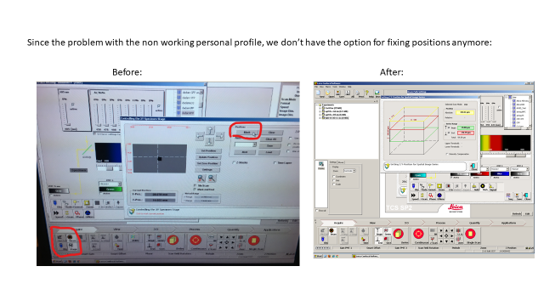
In case of problems with the personal settings:
Sometimes it is not possible to load the personal settings anymore.
Try with ‘RESET personal profile’
After reset it could be that the stage position is not visible anymore, meaning that no positions could be fixed:
Do the following:
Tools-customize-commands-hardware – drag and drop the stage icon to the correct position

Slide 2
Do the following:
Tools-customize-commands-hardware – drag and drop the stage icon to the correct position
Tools - Customize
Hardware – drag and drop the stage icon to the correct position

Slide 3
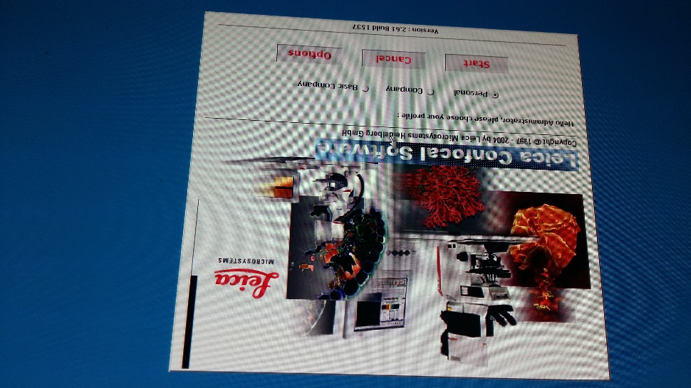
This problem occurs most probably after non starting up correctly. Please follow the correct procedure.
Start up procedure for Leica SP2
- Username: Administrator
Password: admin
- Log on to JALPAN (his computer) NOT TO PSB!!!
- Choose personal settings!

