Slide 1
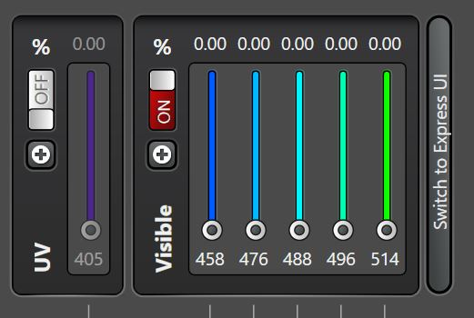

Slide 2
To switch lasers on:

Slide 3
To activate extra laserlines from white light laser:

Slide 4
Button to select 405 laser
Buttons showing the selected lines from the WLL: (max 8)
Buttons to select the different lines from the argon laser

