Slide 1
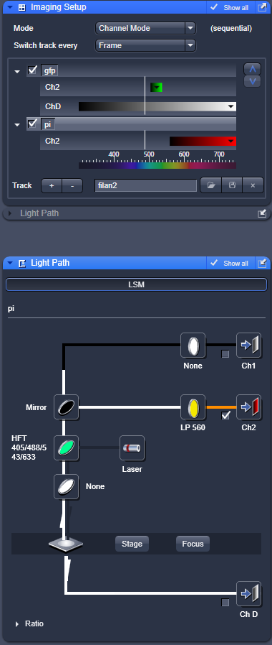
Settings for GFP-PI frame sequential scanning on ONE channel:
Also available when reload settings from this image
S:\research\images\images_cameras\confocal\Help Zeiss Exciter\20191108_Frame sequential scanning GFP PI\GFP and PI_Frame sequential.lsm

Slide 2
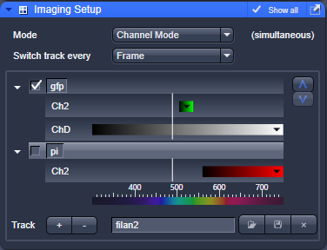
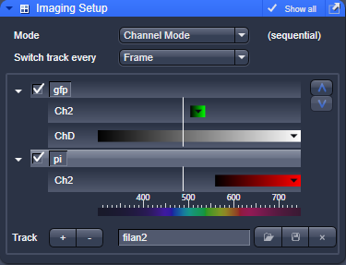
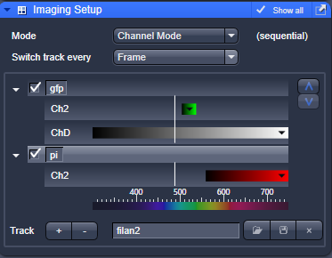
Advicable to first check one channel at a time and adapt each time your settings if needed. This can be done by deactiving one channel. (else changes are not visualized that fast as you are doing frame sequential).
For your final image, select both channels:

