Slide 1
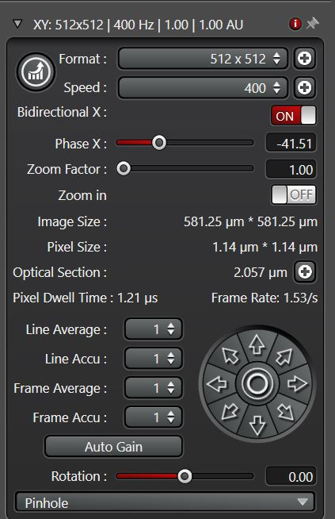
Adaptation of phase X value required to get a normal image (in stead of a ‘split’ image). Probably a value around +/- 20 needs to be obtained.
In the past this phase value didn’t needed to be adapted. This was in most of the cases fine.

