Slide 1
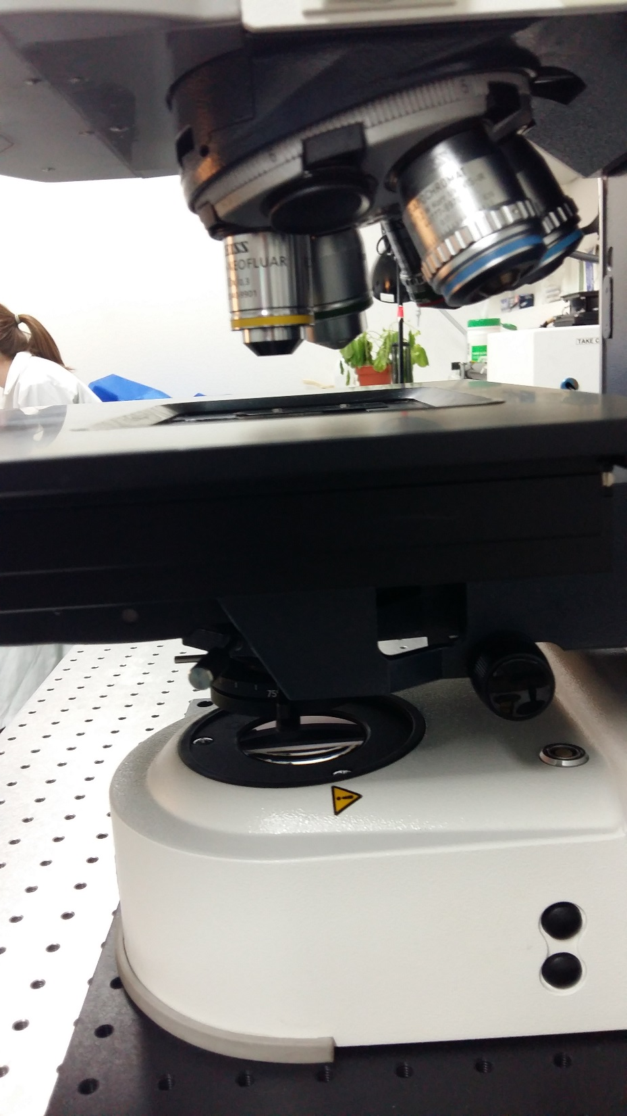
Check the position of the condensor. It should be completely up. You can do this by turning the wheel (indicated in red).
If this is not the case, there will not be enough space for lowering the stage. The microscope will produce a strange noise as it keeps on trying to lower the stage. Finally this could damage the Z-stage!!
Condensor is lowered when people use covered chamber glass in stead of a slide for long time imaging.

