Slide 1
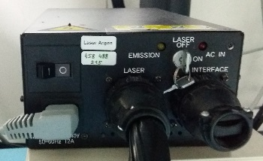
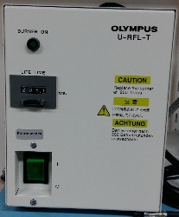

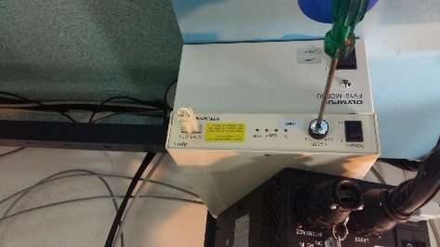
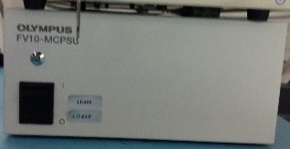

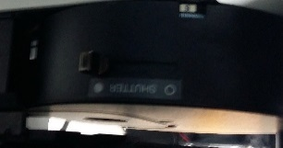
Switching OFF procedure for the Olympus FV1000
Follow the order!
If Argon laser was on
AND it will not be used within 2 hours:
1. Key
Wait till fan of the Argon laser has cooled down +/- 15 min
1
In the meantime you can switch off:
2. (if on And if next user will not use it ) Fluorescence lamp
Only do this!!
2
If 559 laser was on:
3. Key
4. Button
4
Note: As key is broken use the screwdriver
3
5. Exit software
6. Shut down PC
5. Exit software
6. Close PC
After the 15 minutes of argon laser off:
7. Button
7
8. Laser controler
8
9. Main buttons (from right to left, starting with fluorescence)
9
10. Close microscope shutter
(you get warning….
10
Notes:
Add note about warning microscope shutter

